Slide 1

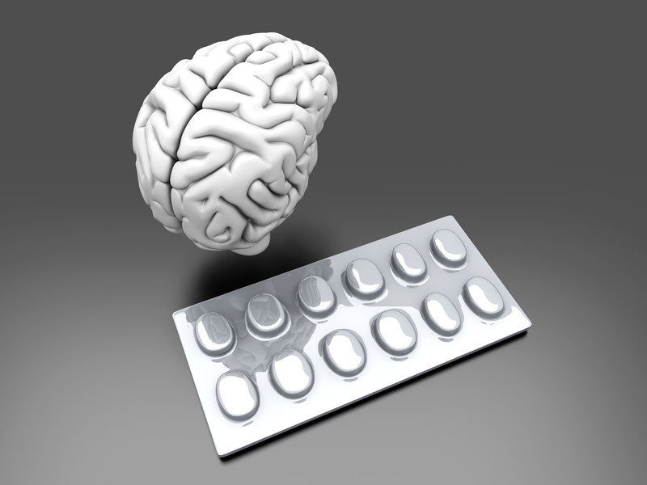
PHARMACOTHERAPY OF PSYCHOSIS AND ANXIETY
BY
DR.G.AARTHIPRIYANKA
POST GRADUATE
DEPARTMENT OF PHARMACOLOGY
RMMC

Slide 2
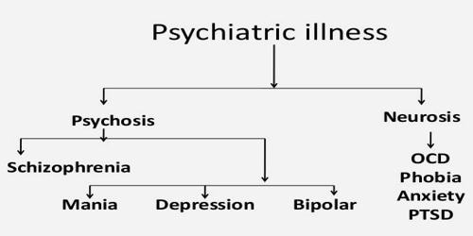
CLASSIFICATION OF PSYCHIATRIC ILLNESS

Slide 3
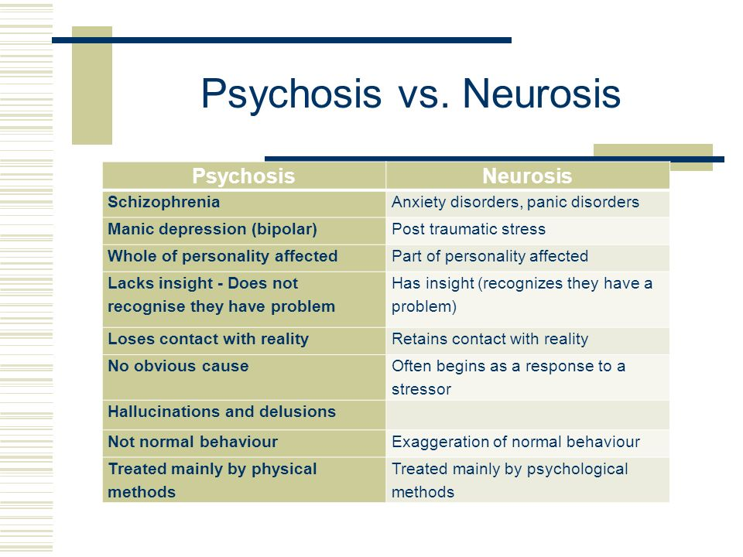
DIFFERENCE BETWEEN PSYCHOSIS AND NEUROSIS

Slide 4


Slide 5
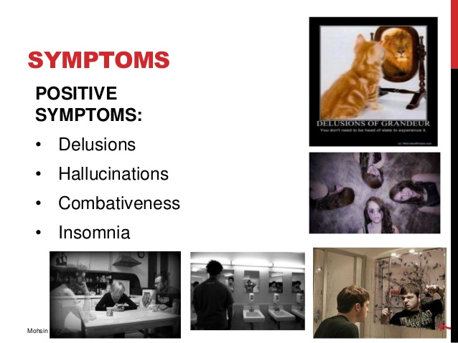
SCHIZOPHRENIA

Slide 6
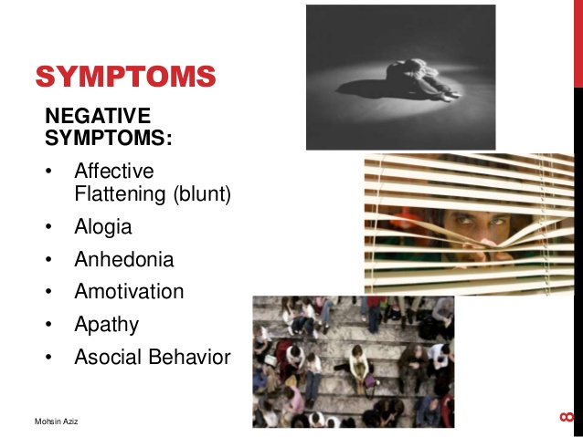
SCHIZOPHRENIA

Slide 7

ANTI PSYCHOTIC DRUGS
Otherwise called as NEUROLEPTICS
Used in schizophrenia,
acute mania
acute psychosis states

Slide 8
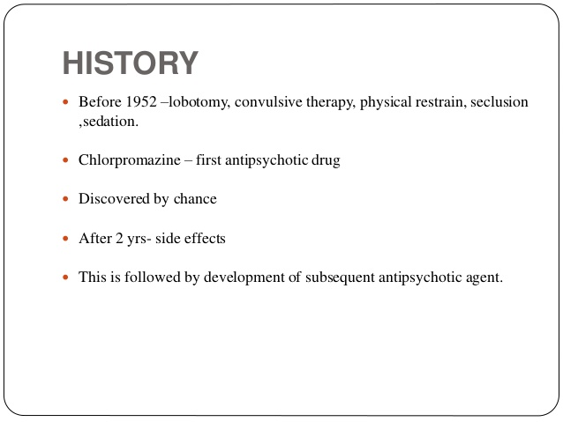

Slide 9
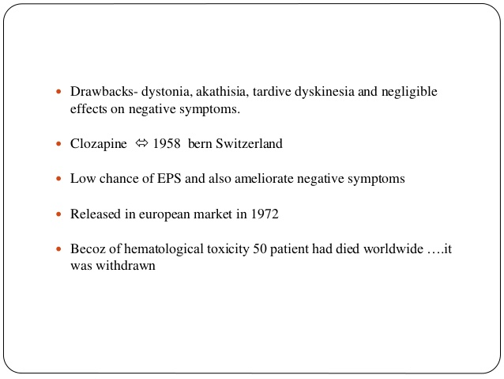

Slide 10
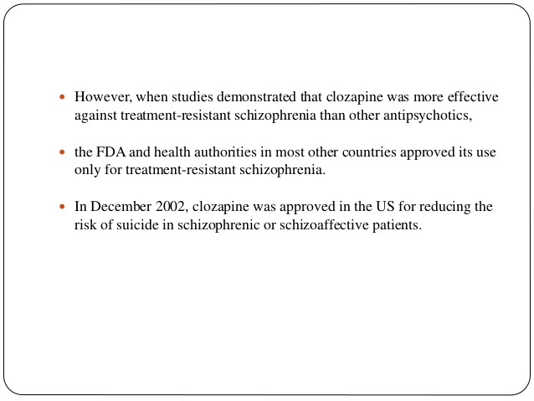

Slide 11
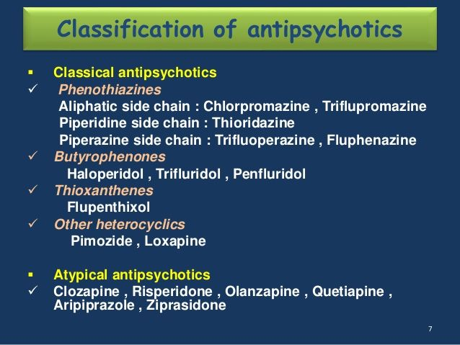
CLASSIFICATION OF ANTIPSYCHOTICS

Slide 12
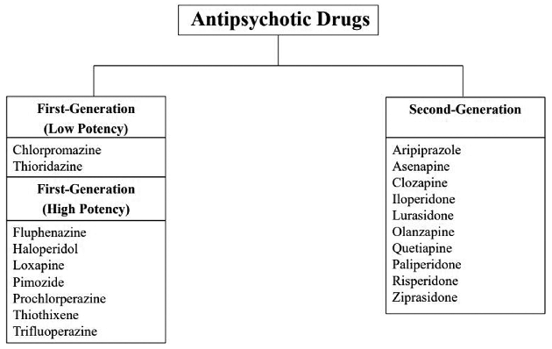

Slide 13
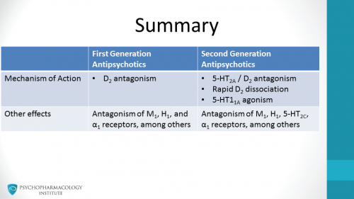
MECHANISM OF ACTION

Slide 14
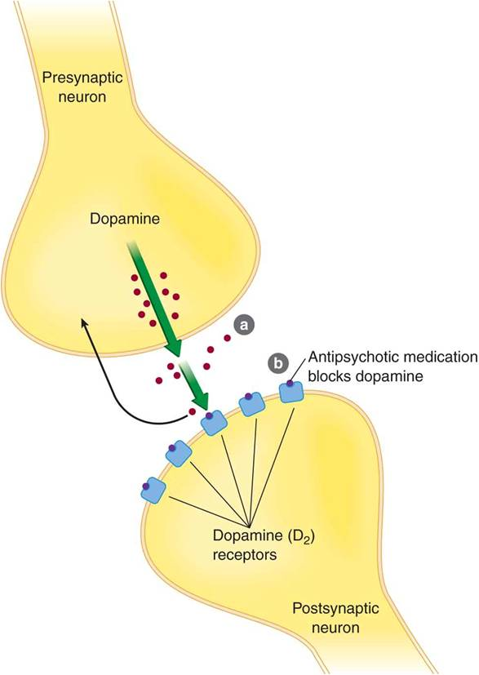
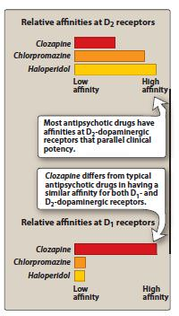
MECHANISM OF ACTION

Slide 15
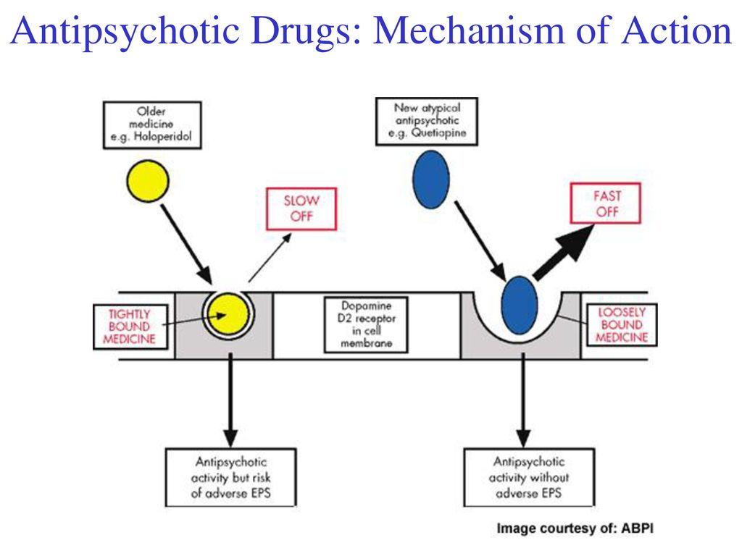

Slide 16
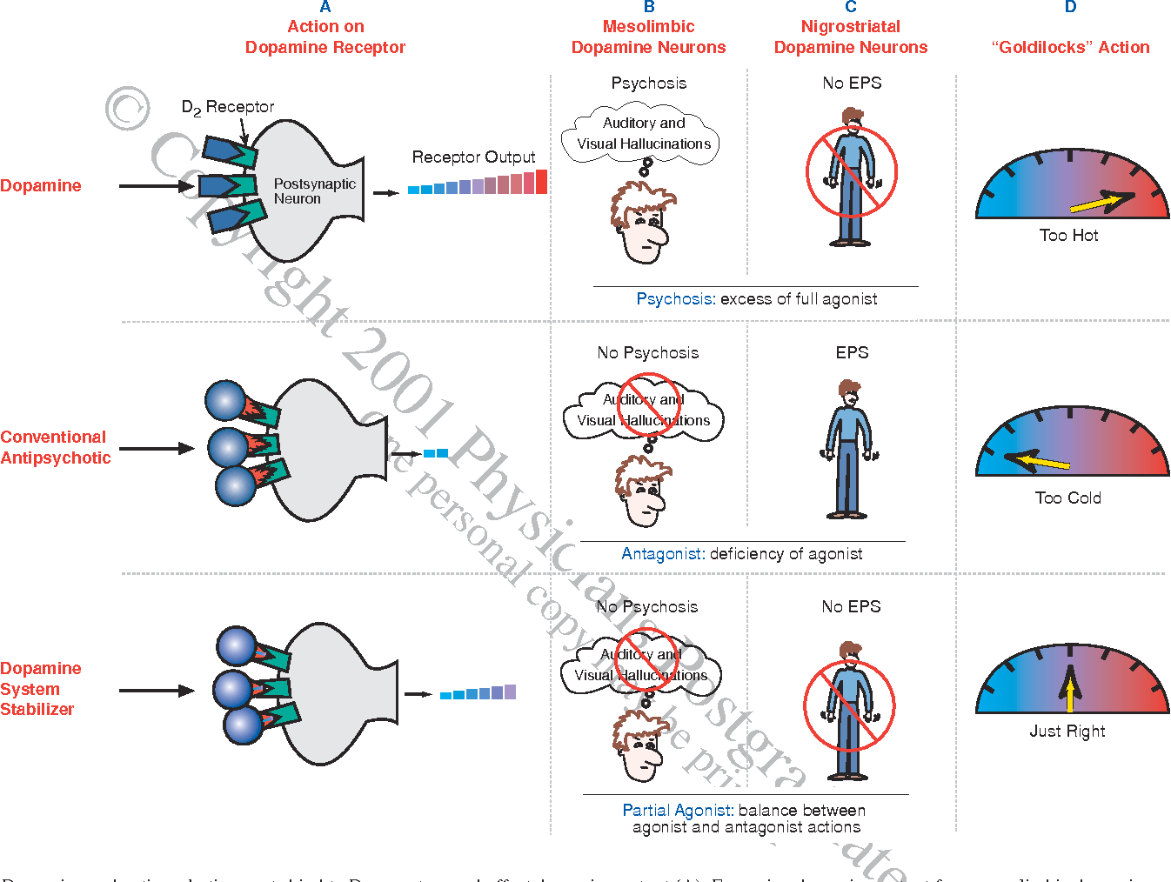

Slide 17
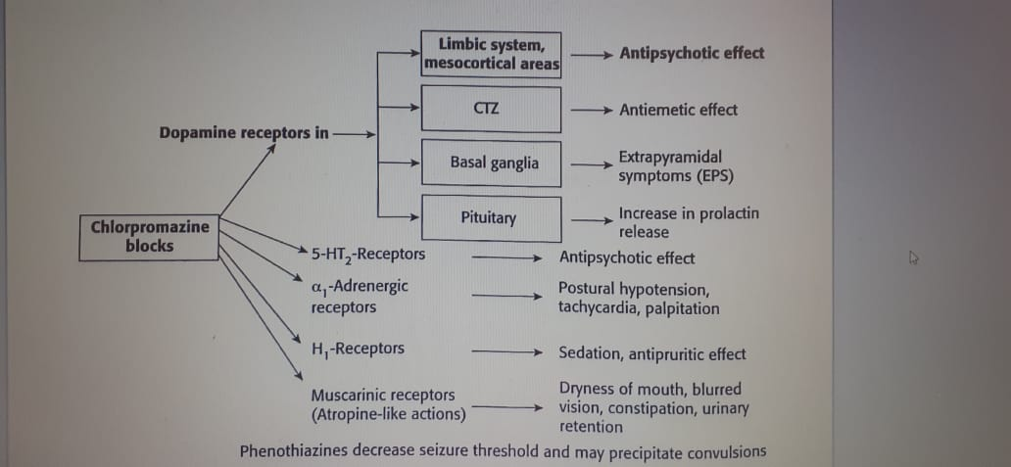
CHLORPROMAZINE prototype drug

Slide 18
PHARMACOKINETICS
Effective orally and parentally
Metabolized in liver
Excreted in urine
Chlorpromazine highly bound to plasma proteins

Slide 19
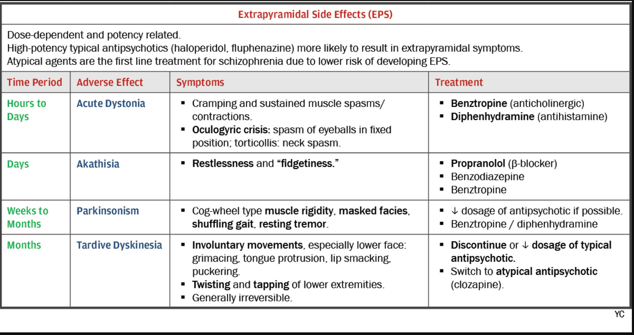
ADVERSE EFFECT

Slide 20
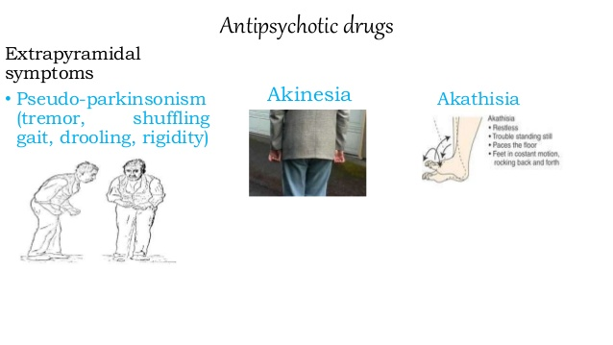

Slide 21
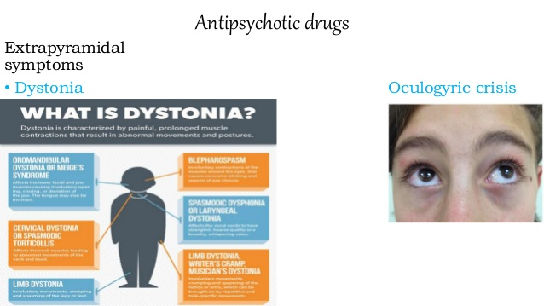

Slide 22
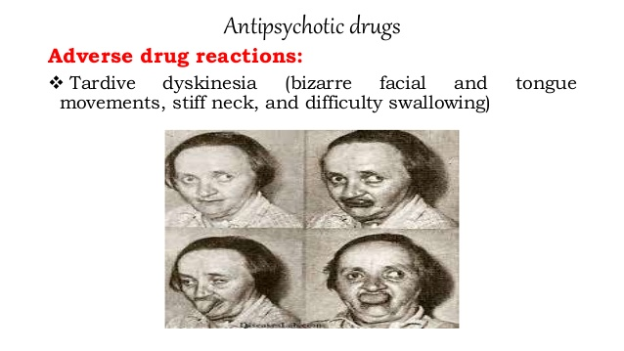

Slide 23
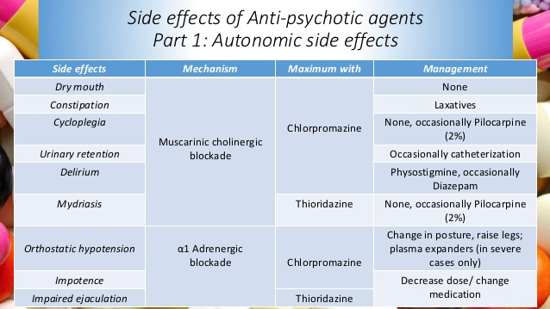

Slide 24
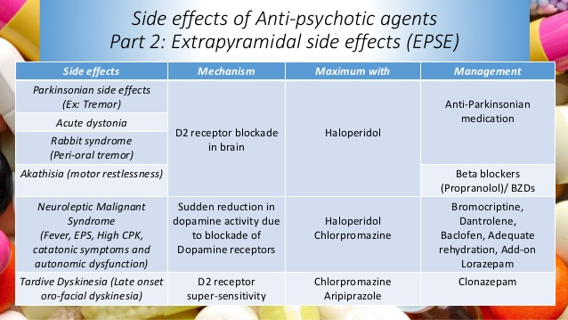

Slide 25
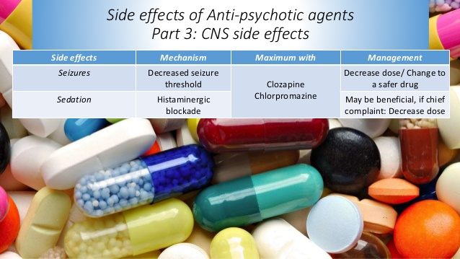

Slide 26
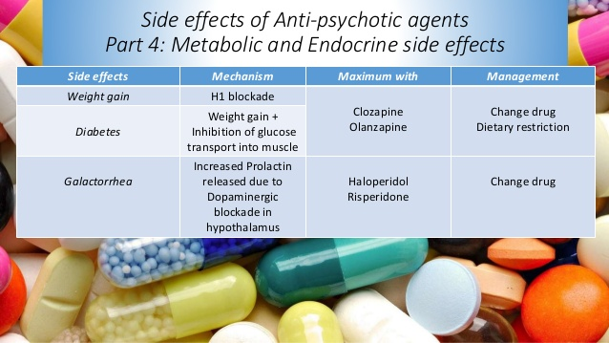

Slide 27
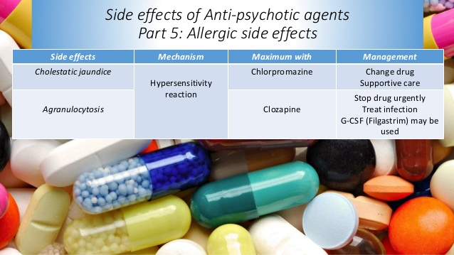

Slide 28
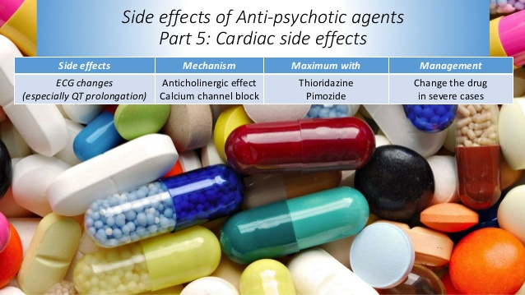

Slide 29
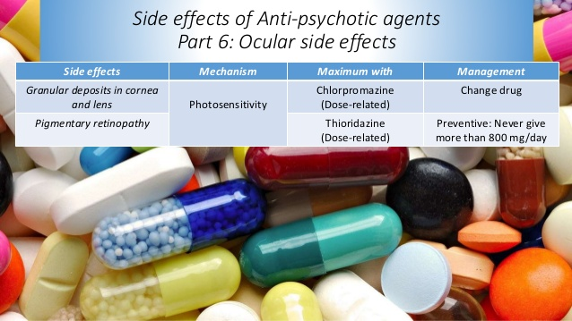

Slide 30
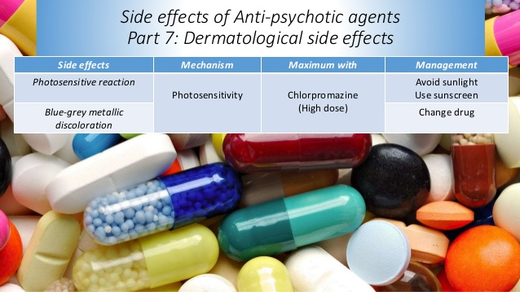

Slide 31
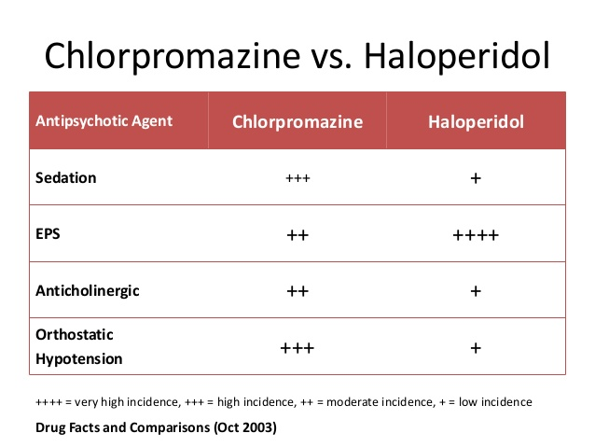

Slide 32
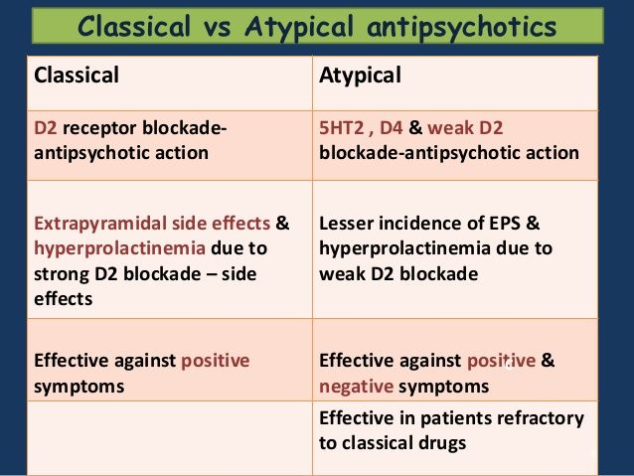

Slide 33
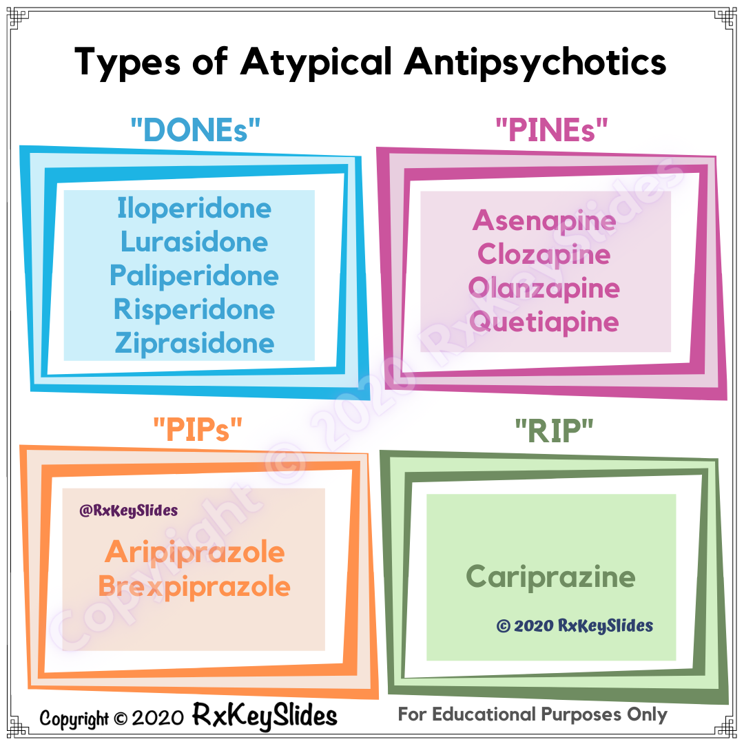

Slide 34
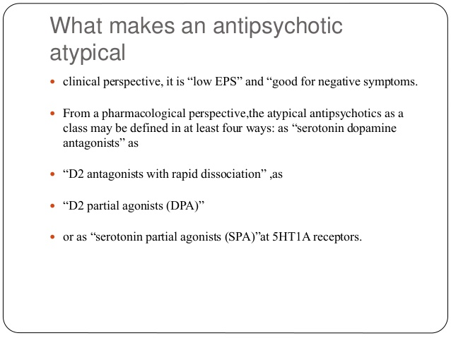

Slide 35
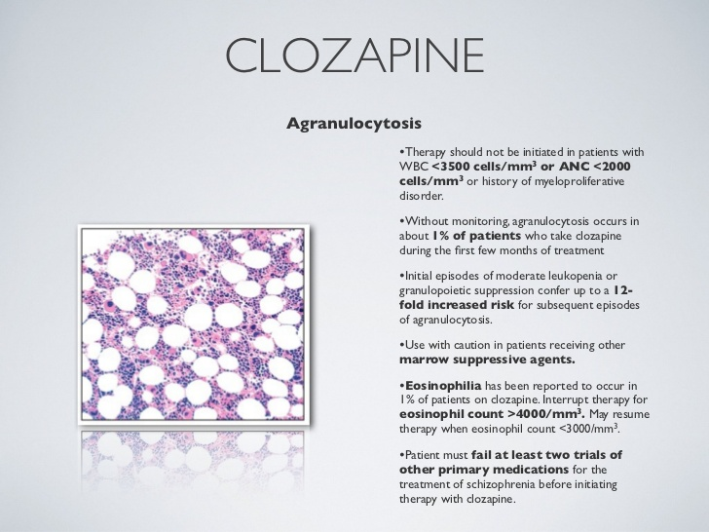
CLOZAPINE
Potent 5HT2A blockade
There will be sedation and hypotension
Low extra pyramidal side effects
AGRANULOCYTOSIS
Weight gain
Precipitate seizures
Hyper salivation
Minimal effect on prolactin
Reserve drug in treatment,
used in resistant cases

Slide 36
OLANZAPINE
Potent 5HT2A blockade
Mild sedation and hypotension
Less EPS
Potent anticholinergic
Weight gain
Hyperglycaemia
Precipitate seizures
Minimal effect on prolactin
Used in SCHIZOPHRENIA associated with MANIA in BIPOLAR DISORDERS

Slide 37
RISPERIDONE
Block 5HT2A,D2,H1,M,ALPHA receptors
Minimal sedation and hypotension
Low doses less than 6mg/day so less EPS
Increases prolactin levels
Less likely to cause seizures
Used in schizophrenia
Used in short term treatment of mania associated with BPD

Slide 38
ZIPRASIDONE,ARIPIPRAZOLE
Less EPS
Minimal effect on prolactin
Less weight gain
Less hyperglycaemia
Used in schizophrenia,mania
Ziprasidone-blocks 5HT2A,D2
Aripiprazole-blocks 5HT2A,D2 partial agonist

Slide 39
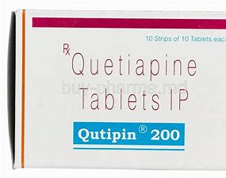
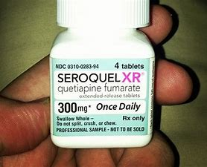
QUETIAPINE
Block 5HT2A,D2
More sedation
QT PROLONGATION

Slide 40
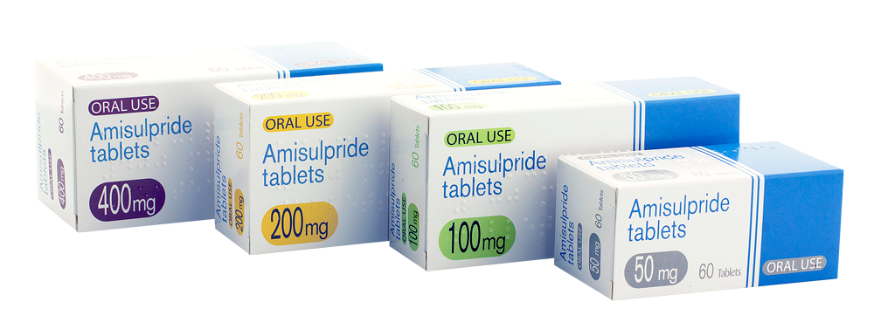
AMISULPIRIDE
D2 blockade
Less EPS
QT PROLONGATION

Slide 41
ANTI ANXIETY DRUGS
Benzodiazepines
Buspirone
Beta blockers
Selective serotonin reuptake inhibitors(SSRI’s)
Serotonin and noradrenaline reuptake inhibitors(SNRI)
H1-blocker

Slide 42
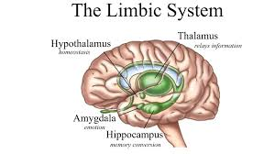
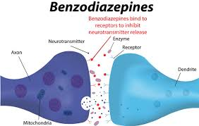
BENZODIAZEPINES
Preferred anxiolytic drugs
Chlordiazepoxide,diazepam,lorazepam,oxazepam,nitrazepam,flurazepam,alprazolam
Act on __________
_____________ effect of GABA
Short term treatment of Anxiety
Act rapidly so acute anxiety
ADVERSE EFFECT:sedation,impairment of memory,confusion,dependence
Tolerance---long term use

Slide 43
BUSPIRONE
Partial agonist of 5HT1A receptor-selective anxiolytic effect
No sedative,anticonvulsant or muscle relaxant property
Doesnot potentiate central effects of alcohol or other CNS depressants
No tolerance or drug dependence
Does not affect GABA transmission
Well absorbed from GI tract,bioavailability is low because of first pass metabolism
Effect is delayed and may take 2 weeks to fully develop,so not effective for acute cases

Slide 44
BETA BLOCKERS
Propanalol
Used to reduce symptoms of anxiety such as
tachycardia
palpitation
tremor
sweating

Slide 45
SSRI,SNRI
Except acute anxiety
Response is delayed

Slide 46
H1-BLOCKER
HYDROXYZINE
Highly sedative first generation H1 blocker
Selective antianxiety action
Antiallergic
Antiemetic
Antichlinergic actions

Slide 47

00000000000000000000000000000000000000000000000000000000000000000000000000000000000000000000000000000000

